Slide 1

MALWARE DETECTION
USING MACHINE LEARNING MODELS
Presented By:
Batch-164
211FA04559
211FA04615
211FA04623
Presented to:
G. Parimala,
Assistant Professor,
Dept of CSE,
Vignan University

Slide 2

Contents
Abstract
Problem Identification
Objective
Dataset Description
Data Preprocessing
Methodology
Tools & Technologies Used
How we reached our Objective
Model Comparison Table
Results
References

Slide 3

Abstract
Malware is harmful software that can damage computers, steal data, and create security risks.
It includes trojans, ransomware, and spyware.
Detecting malware is important to protect computer systems.
The main goal of this project is to create a Machine Learning (ML) model that can identify whether a system's behavior is safe (Benign) or harmful (Malware).
It will detect different types of malware, such as
1.Trojan Horse
2.Ransomware
3.Spyware

Slide 4
Problem Identification
Limitations of Traditional Antivirus & Advantages of Machine Learning
Why Traditional Antivirus Software Fails?
❌ Traditional antivirus uses signatures to detect malware. ❌ Hackers create new versions of malware to avoid detection. ❌ Antivirus needs constant updates → cannot detect new malware instantly.
Why Use Machine Learning for Malware Detection?
✔️ Machine Learning can learn patterns from past malware. ✔️ Can detect new types of malware even if it has no signature. ✔️ Works faster than traditional antivirus scanning.

Slide 5
Objective
🎯Main Goal:
Build a Machine Learning model to detect malware from memory dumps.
Sub-goals:
Collect and preprocess memory dump data
Extract important features that indicate malware presence
3.Compare different ML models and find the most accurate one.
4.Optimize model performance for real-time malware detection.

Slide 6
Dataset Description
This dataset was collected from the Kaggle
This dataset contains memory dump data used to detect malware infections in a system.
It is used to detect malware by analysing system memory dumps.
It contains normal (benign) and malicious samples, allowing us to train machine
Learning models to classify threats effectively
Dataset Name: Malware Detection from Memory Dumps Source: Kaggle (subha journal/malware-detection-from-memory-dump) Purpose: Identify malware infections based on memory dump features
The dataset contains 58 columns (features) that describe various system activities like:
Number of processes
Number of handles
Malware Indicators & Hidden Activity
Number of threads
Different types of services running on the system

Slide 7
Data Preprocessing
Before using the dataset for training machine learning models, we clean and prepare the data through the following steps:
✔ Remove missing values – Fill empty values with average values ✔ Remove duplicate rows – Ensure no repeated data ✔ Label encoding – Malware types (Benign, Trojan, Spyware, Ransomware) are
converted into numbers
✔ Feature scaling – Normalize data for uniformity
Benign(safe) → 0
Ransomware → 1
Spyware → 2
Trojan Horse → 3

Slide 8
Methodology
Methodology is about developing and testing the model before using it.
It ensures we choose the best approach for detecting malware accurately.
1️⃣Data Splitting:
80% of the data was used to train the model.
20% of the data was used to test how well it works.
2️⃣ Feature Selection:
We selected only the most important features to improve accuracy.
3️⃣ Model Training:
We trained Decision Tree, Random Forest, KNN, and Stacking Classifier(Combined multiple models.
4️⃣ Model Testing & Evaluation:
Each model was tested for accuracy, precision, and recall.
5️⃣ Final Model Selection:
The Stacking Classifier performed best (94% accuracy)

Slide 9
Tools & Technologies Used
We used different tools to build and test our malware detection system:
Python – Programming language for building the system.
Scikit-Learn – Library for training and testing machine learning models.
Pandas & NumPy – Used for handling and processing data.
Matplotlib & Seaborn – Used for data visualization and analysis.
Visual Studio Code – Helps us write and run ML code interactively.
✅ Tools and technology help in building, training, and running the malware detection system effectively.

Slide 10
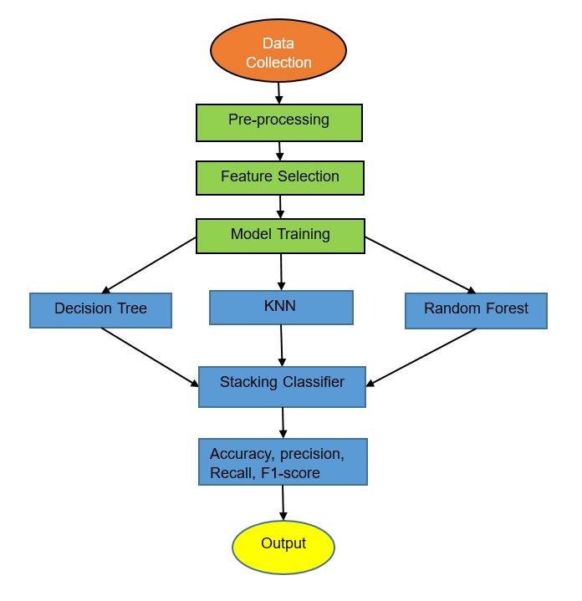

Proposed Model Diagram

Slide 11
How we reached our Objective
Before using the data for training models, the following steps are done:
Collected and analyzed memory dump data.
Applied data preprocessing techniques.
Identified most relevant features for classification.
Implemented multiple machine learning models.
Evaluated models based on accuracy and other metrics.
Selected Stacking Classifier as the best-performing model with 94.0% accuracy.

Slide 12
Results
We trained several Machine Learning models to identify malware:
A stacking classifier is an ensemble learning method that combines multiple machine learning models to improve accuracy.
Feature selection improved model efficiency and accuracy.
Model | Accuracy | Precision | Recall | F1_score
Decision Tree | 81.5 | 74.4 | 72.1 | 73.2
Random Forest | 87 | 81 | 80.5 | 80.7
KNN | 82.4 | 75 | 74.6 | 74.8
Stacking classifier | 94 | 91 | 91.2 | 91.1

Slide 13
References
[1]Bensaoud, J. Kalita, and M.Bensaoud, "A Survey of Malware Detection Using Deep Learning," arXiv preprint arXiv:2407.19153, Jul. 2024. [Online]. https://arxiv.org/abs/2407.19153
[2] F.Alshmarni and M. A.Alliheedi, "Enhancing Malware Detection by Integrating Machine Learning with Cuckoo Sandbox," arXiv preprint arXiv:2311.04372, Nov. 2023. [Online]. Available: https://arxiv.org/abs/2311.04372
[3] M. Omar, "New Approach to Malware Detection Using Optimized Convolutional Neural Network," arXiv preprint arXiv:2301.11161, Jan. 2023. [Online]. https://arxiv.org/abs/2301.11161 Available:
[4] P. Maniriho, A. N. Mahmood, and M. J. M. Chowdhury, "Deep Learning Models for Detecting Malware Attacks," arXiv preprint arXiv:2209.03622, Sep. 2022. [Online]. Available: https://arxiv.org/abs/2209.03622
[5] A. Bensaoud, J. Kalita, and M. Bensaoud, "A Survey of Malware Detection Using Deep Learning," arXiv preprint arXiv:2407.19153, Jul. 2024. [Online]. https://arxiv.org/abs/2407.19153 Available:
[6] A. F. Alshmarni and M. A. Alliheedi, "Enhancing Malware Detection by Integrating Machine Learning with Cuckoo Sandbox," arXiv preprint arXiv:2311.04372, Nov. 2023. [Online]. Available: https://arxiv.org/abs/2311.04372
[7] P. Maniriho, A. N. Mahmood, and M. J. M. Chowdhury, "Deep Learning Models for Detecting Malware Attacks," arXiv preprint arXiv:2209.03622, Sep. 2022. [Online]. Available: https://arxiv.org/abs/2209.03622

